Slide 1

Slides for Chapter 10:
Peer-to-Peer Systems
From Coulouris, Dollimore and Kindberg
Distributed Systems:
Concepts and Design
Edition 4, © Addison-Wesley 2005

Slide 2
Figure 10.1: Distinctions between IP and overlay routing for peer-to-peer applications

Slide 3
Figure 10.2: Napster: peer-to-peer file sharing with a centralized, replicated index

Slide 4
Figure 10.3: Distribution of information in a routing overlay

Slide 5
Figure 10.4: Basic programming interface for a distributed hash table (DHT) as implemented by the PAST API over Pastry
put(GUID, data)
The data is stored in replicas at all nodes responsible for the object identified by GUID.
remove(GUID)
Deletes all references to GUID and the associated data.
value = get(GUID)
The data associated with GUID is retrieved from one of the nodes responsible it.

Slide 6
Figure 10.5: Basic programming interface for distributed object location and routing (DOLR) as implemented by Tapestry
publish(GUID )
GUID can be computed from the object (or some part of it, e.g. its name). This function makes the node performing a publish operation the host for the object corresponding to GUID.
unpublish(GUID)
Makes the object corresponding to GUID inaccessible.
sendToObj(msg, GUID, [n])
Following the object-oriented paradigm, an invocation message is sent to an object in order to access it. This might be a request to open a TCP connection for data transfer or to return a message containing all or part of the object’s state. The final optional parameter [n], if present, requests the delivery of the same message to n replicas of the object.

Slide 7
Figure 10.6: Circular routing alone is correct but inefficient
Based on Rowstron and Druschel [2001]
The dots depict live nodes. The space is considered as circular: node 0 is adjacent to node (2128-1). The diagram illustrates the routing of a message from node 65A1FC to D46A1C using leaf set information alone, assuming leaf sets of size 8 (l = 4). This is a degenerate type of routing that would scale very poorly; it is not used in practice.

Slide 8
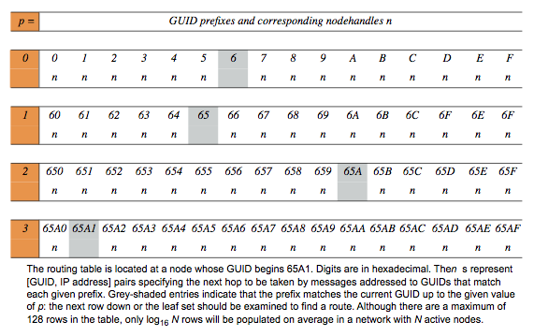
Figure 10.7: First four rows of a Pastry routing table

Slide 9
Figure 10.8: Pastry routing example Based on Rowstron and Druschel [2001]

Slide 10
Figure 10.9: Pastry’s routing algorithm

Slide 11
Figure 10.10: Tapestry routing From [Zhao et al. 2004]

Slide 12
Figure 10.11: Storage organization of OceanStore objects
AGUID
certificate
VGUID of current
version
version i+1
VGUID of
version i
d1
d2
BGUID (copy on write)
d3
root block
version i
indirection blocks
data blocks
d1
d2
d3
d4
d5
VGUID of version i-1

Slide 13
Figure 10.12: Types of identifier used in OceanStore
Name
Meaning
Description
BGUID
block GUID
Secure hash of a data block
VGUID
version GUID
BGUID of the root block of a version
AGUID
active GUID
Uniquely identifies all the versions of an object

Slide 14
Figure 10.13: Performance evaluation of the Pond prototype emulating NFS
LAN
WAN
Predominant
operations in
Phase
Linux NFS
Pond
Linux NFS
Pond
benchmark
1
0.0
1.9
0.9
2.8
Read and write
2
0.3
11.0
9.4
16.8
Read and write
3
1.1
1.8
8.3
1.8
Read
4
0.5
1.5
6.9
1.5
Read
5
2.6
21.0
21.5
32.0
Read and write
Total
4.5
37.2
47.0
54.9

Slide 15
Figure 10.14: Ivy system architecture

